Slide 1

Deloitte Pre Hire Training 2017
FOUNDATION TRAINING
ORM With Hibernate

Slide 2
ORM with Hibernate 3.5
Mapping Inheritance and HQL

Slide 3
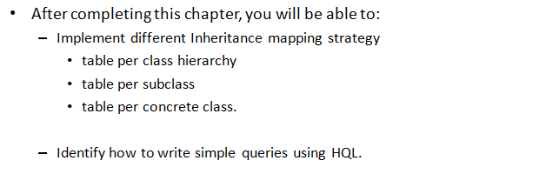
Objectives

Slide 4
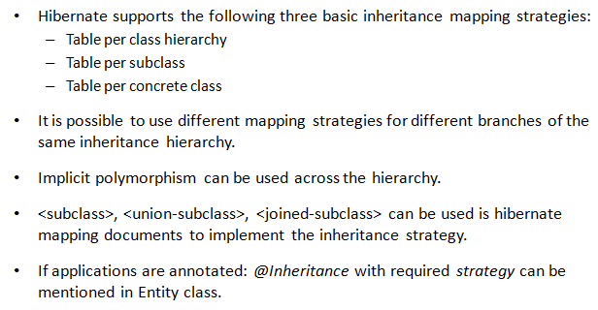
Hibernate and Entity Inheritance

Slide 5
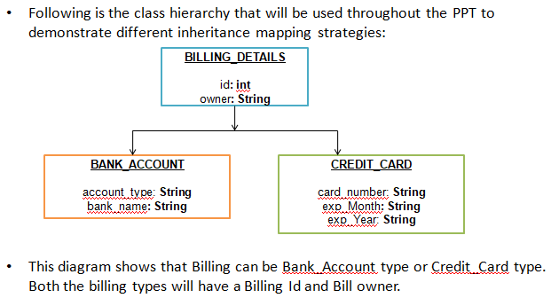
Class Hierarchy

Slide 6
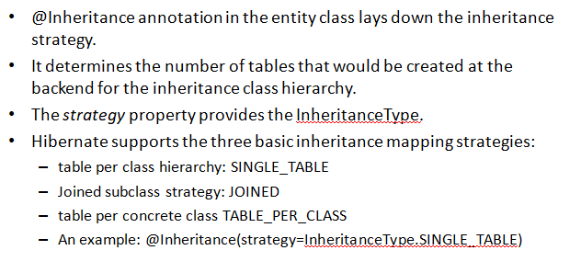
@Inheritance Annotation

Slide 7
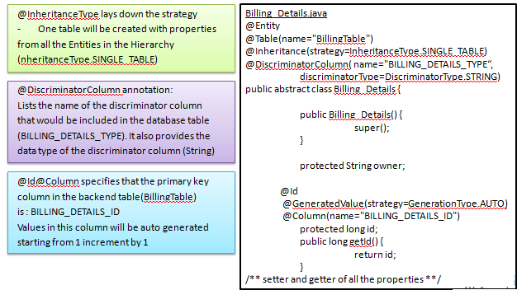
One Table Per Hierarchy-Parent Class

Slide 8
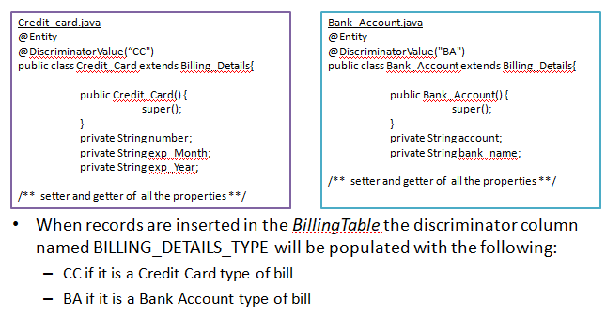
One Table Per Hierarchy-Child Class

Slide 9
Demo
Write a simple application explaining one-table-per hierarchy

Slide 10
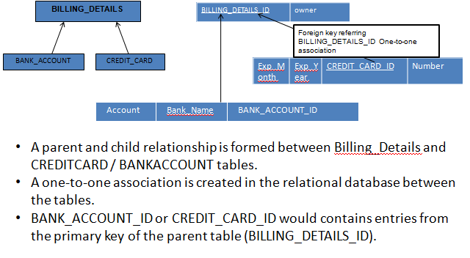
Joined Subclass Strategy

Slide 11
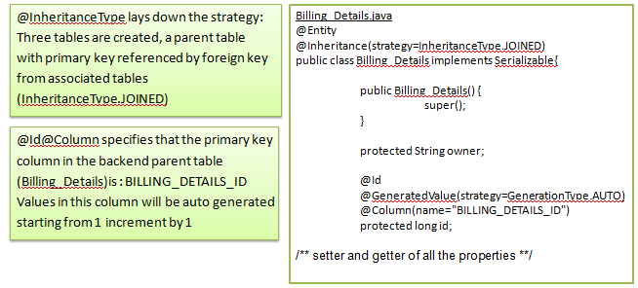
Joined Subclass – Parent Class

Slide 12
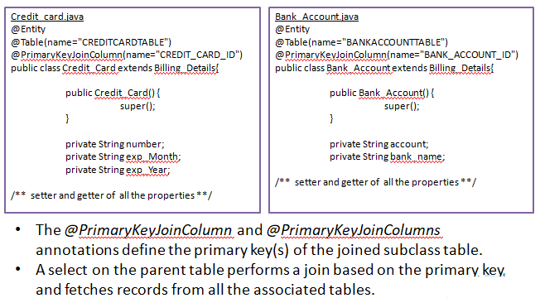
Joined Subclass – Child Class

Slide 13
Demo
Write a simple application explaining Joined Subclass

Slide 14
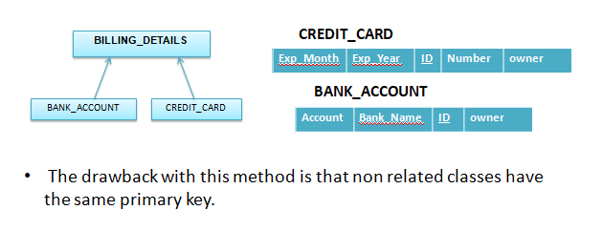
One Table Per Concrete Class

Slide 15
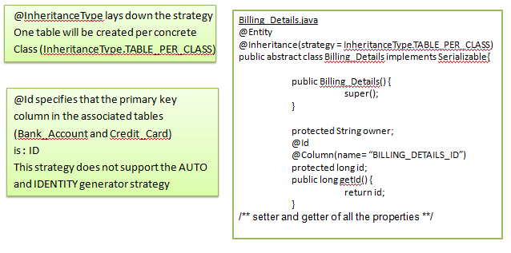
One Table Per Concrete Class – Parent Class

Slide 16
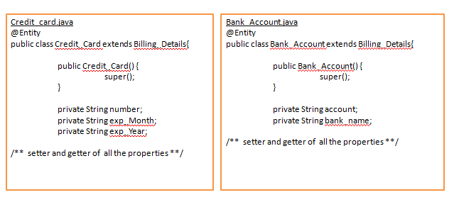
One Table Per Concrete Class – Child Class

Slide 17
Demo
Write a simple application explaining one-table-per concrete class

Slide 18
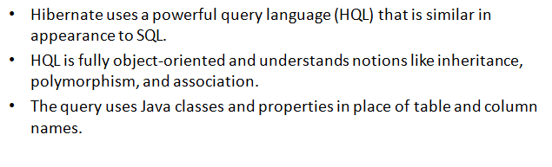
Hibernate Query Language

Slide 19
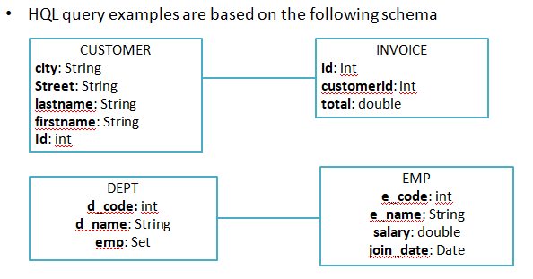
Sample Class Model

Slide 20
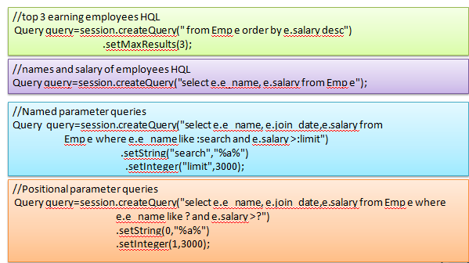
Examples of HQL

Slide 21
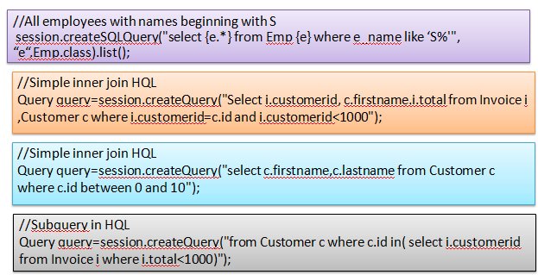
Examples of HQL

Slide 22
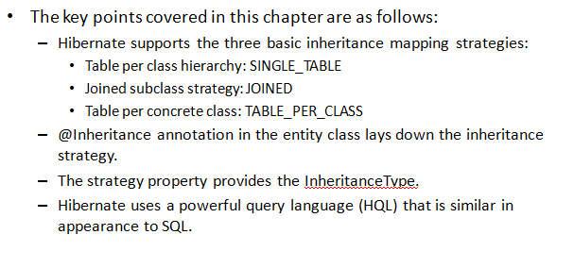
Summary

